Slide 1
Project KEYLOGGER AND SECURITY
Presented By
R.THANGA SHYAMALA – CSE DEPT
HOLYCROSS ENGINEERING COLLEGE

Slide 2
OUTLINE
INTRODUCTION
PROBLEM STATEMENT
KEYLOGGERS
TYPES OF KEYLOGGERS
PREVENTION
WORKING
LIBRARIES AND SOFTWARE
CONCLUSION
REFERENCE
FUTURE SCOPE

Slide 3
INTRODUCTION
The proposed system aims to address the challenge of keylogger security system. This involves requirement analysis ,.
The solution will consist of the following components:
Requirement analysis:
The timing of the email and the email address can be changed later in the settings.
The daily report will be mailed to the PC owner on his/her email.
Keyboard monitoring:
Python 3 library pynput is used for on screen keyboard.
These keystrokes saved in text file will be maintained for 7 days.
Maintaing the log file :
The keylogger will maintain the files containing the keystrokes for a maximum of 7 days.
The program will then automatically delete the past files.
This settings can also be changed later.
Prevention:
Antivirus
Automatic form fillers
On screen Keyboard

Slide 4
TitLE - KEYLOGGER AND SECURITY:
Problem statement : In today’s digital age, where cybersecurity threats loom large, one of the significant concerns is the proliferation of keyloggers, stealthy software tools designed to monitor and record keystrokes on a user’s computer without their knowledge.Keyloggers pose a severe threat to individuals and organizations as they can capture sensitive information such as passwords,credit card details,and other personal data,leading to identify theft,financial loss,and privacy breaches

Slide 5
KEYLOGGERS
Keyloggers are a type of malware that is downloaded onto a device through an entry point. Entry points can be infected software, emails, files or cloud programs. When keylogging software gets installed on a victim’s device, it logs every keystroke to gather login credentials and other sensitive information.
Keyloggers can operate at different levels of a computer's operating system. Some keyloggers are software-based, where they are installed on a target system like any other software application. Others are more sophisticated and can be implemented at the hardware level, often requiring physical access to the targeted computer or device. Modern keyloggers can capture more than just keystrokes; they can also record screenshots, clipboard contents, and even microphone or webcam inputs.
A keylogger’s primary purpose is to capture sensitive information from the person using the targeted device, such as passwords, credit card numbers, personal messages, and other confidential data that users type on their keyboards. Keyloggers can be used for various purposes, including cybercrime, espionage, or unauthorized monitoring.

Slide 6
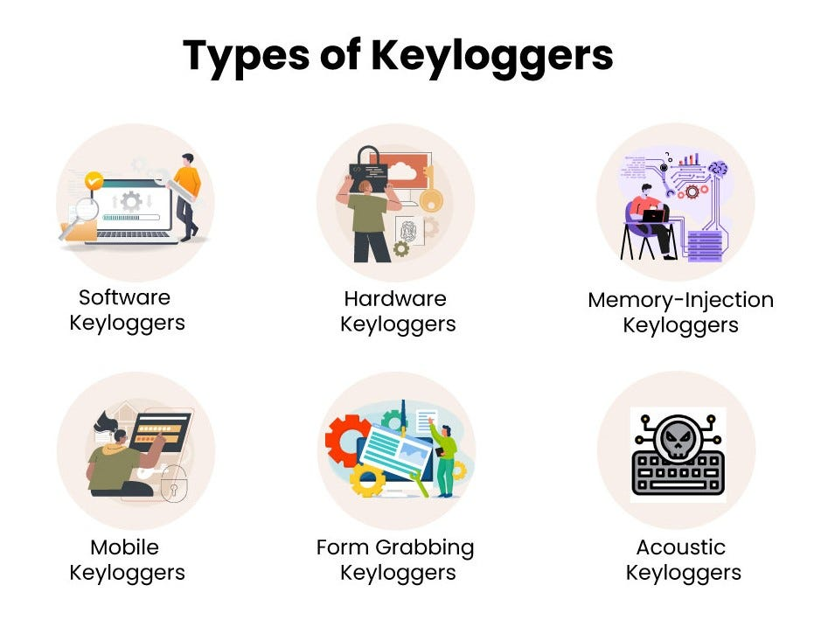
6

Slide 7
HARDWARE KEYLOGGER
Hardware keyloggers are physical devices that are attached to a target computer or keyboard. They can be plugged into a USB port, placed between the computer and the keyboard cable, or integrated into the computer hardware itself (e.g., inside a keyboard or laptop). Hardware keyloggers record keystrokes directly as they pass through the keyboard before they even reach the computer's operating system.
USB keylogger – There are USB connector key-loggers which has to be connected to a computer and steals the data. Also some circuits are built into a keyboard so no external wire i used or shows on the keyboard.
Smartphone sensors – Some cool android tricks are also used as key loggers such as android accelerometer sensor which when placed near to the keyboard can sense the vibrations and the graph then used to convert it to sentences, this technique accuracy is about 80%. Now a days crackers are using keystroke logging Trojan, it is a malware which is sent to a victims computer to steal the data and login details.

Slide 8
SOFTWARE KEYLOGGER
Software key-loggers : Software key-loggers are the computer programs which are developed to steal password from the victims computer. However key loggers are used in IT organizations to troubleshoot technical problems with computers and business networks. Also Microsoft windows 10 also has key-logger installed in it.
JavaScript based key logger – It is a malicious script which is installed into a web page, and listens for key to press such as oneKeyUp(). These scripts can be sent by various methods, like sharing through social media, sending as a mail file, or RAT file.
Form Based Key loggers – These are key-loggers which activates when a person fills a form online and when click the button submit all the data or the words written is sent via file on a computer. Some key-loggers works as a API in running application it looks like a simple application and whenever a key is pressed it records it.

Slide 9
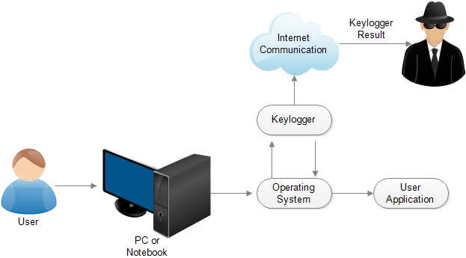
WORKING

Slide 10
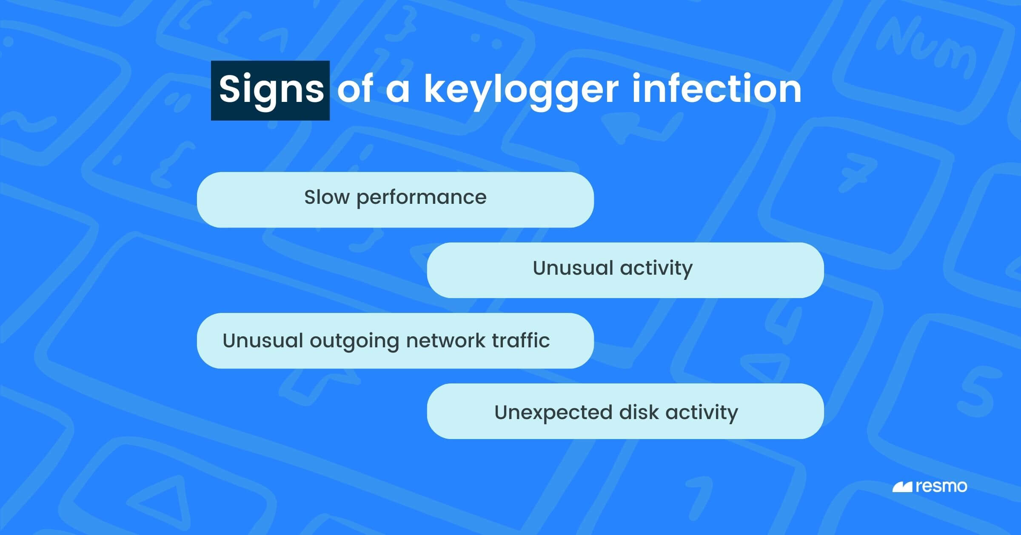
SIGNS

Slide 11
How to prevent KEYLOGGER
Two-Factor Authentication
Only Download Safe File
Install Antivirus Software
Use a Password Manager

Slide 12
Required libraries & software
LIBRARIES
Python idle
pip install pynput
pip install jsonlib

Slide 13
Conclusion
Keyloggers are a potent threat to both individuals and enterprises with the potential to cause significant harm if left undetected . Understanding the nature of keyloggers , their methods of infiltration , and the dangers they pose is crucial for maintaining a secure digital environment.

Slide 14
FUTURE SCOPE
The development of more advanced encryption methods to protect against keyloggers.Additionally,there could be advancements in behavioral analysis techniques to detect and prevent keylogging attempts . Some potential areas of focus include developing machine learning algorithms to detect unusual typing patterns ,enhancing real-time monitoring systems, and improving user education about the risks and prevention of keyloggers.

Slide 15
REFERENCES
REFERENCES [1] Working of Keyloggers available at http://securelist.com/analysis/publications/36138/keyloggers-how-theywork-and-how-todetect-them-part-1. [2] C.a.Rajendra.”Keylogger in Cybersecurity Education”. Rechester Institute of Technology,Rechester,New York,USA. [3] M. Aslam, R. N. Idrees, M. M. Baig, and M. A.Arshad, “Antihook shield against the software key loggers,” in Proceedings of the National Conference of Emerging Technologies,2004. [4] E. S. L. Martignoni, M. Fredrikson, S. Jha, and J. C. Mitchell, "A layered architecture for detecting malicious behaviors,”.Heidelberg.2008 [5] C. Y. D. Le, T. Smart, and H. Wang,, "Detecting kernel level keyloggers through dynamic taint analysis," College of William & Mary, Department of Computer Science, illiamsburg,,2008. [6] C. G. S.Ortani, and Crispo.”Bait your Hook: A novel Detection technique for keylogger”. University of Trento, Via Sommarive.Trento, Italy.2010. [7] S.S.a.Anith.

Slide 16


